Slide 1
ORACLES Forecast Briefing (Aerosols)
25 September 2016

Slide 2
The Aerosol Week

Slide 3
Walvis Bay
Dust
OC+BC+SO4

Slide 4
Ascension: GEOS-5 OC+BC+SO4

Slide 5
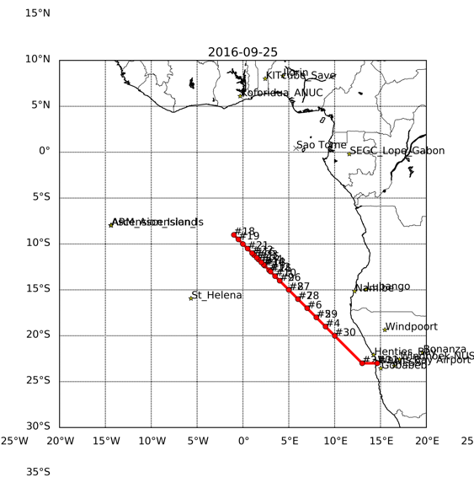
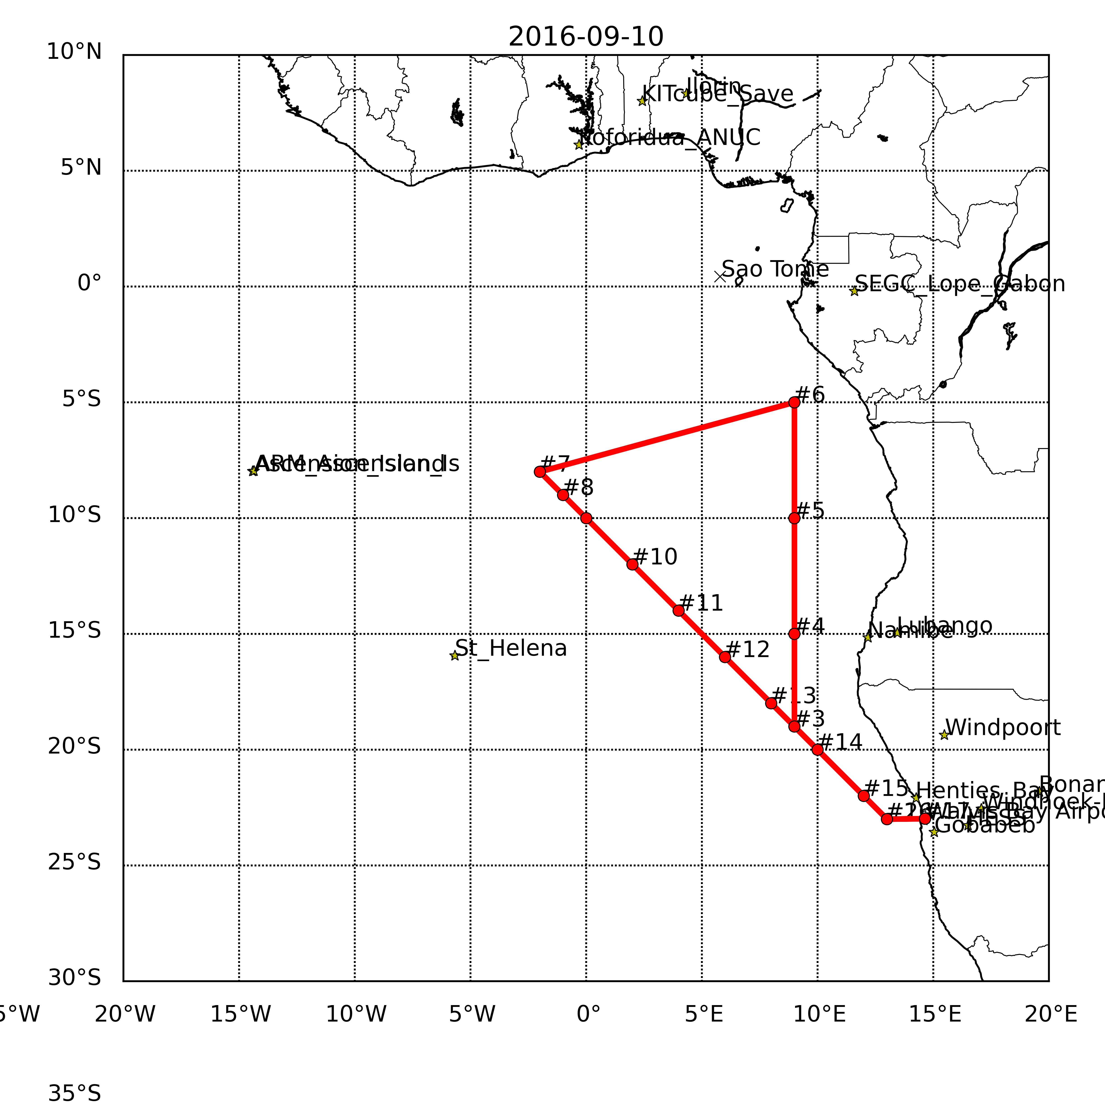
Sunday 25 September 2016
Flight Day

Slide 6
Sunday, 25 Sep 2016 9Z

Slide 7
Sunday, 25 Sep 2016 9Z
HIGH

Slide 8
Sunday, 25 Sep 2016 9Z
MID

Slide 9
Sunday, 25 Sep 2016 9Z
LOW

Slide 11
Sunday, 25 Sep 2016 9Z

Slide 12
Sunday, 25 Sep 2016 9Z

Slide 13
monday 26 September 2016
Hard-Down Day

Slide 14
Monday, 26 Sep 2016 9z

Slide 15
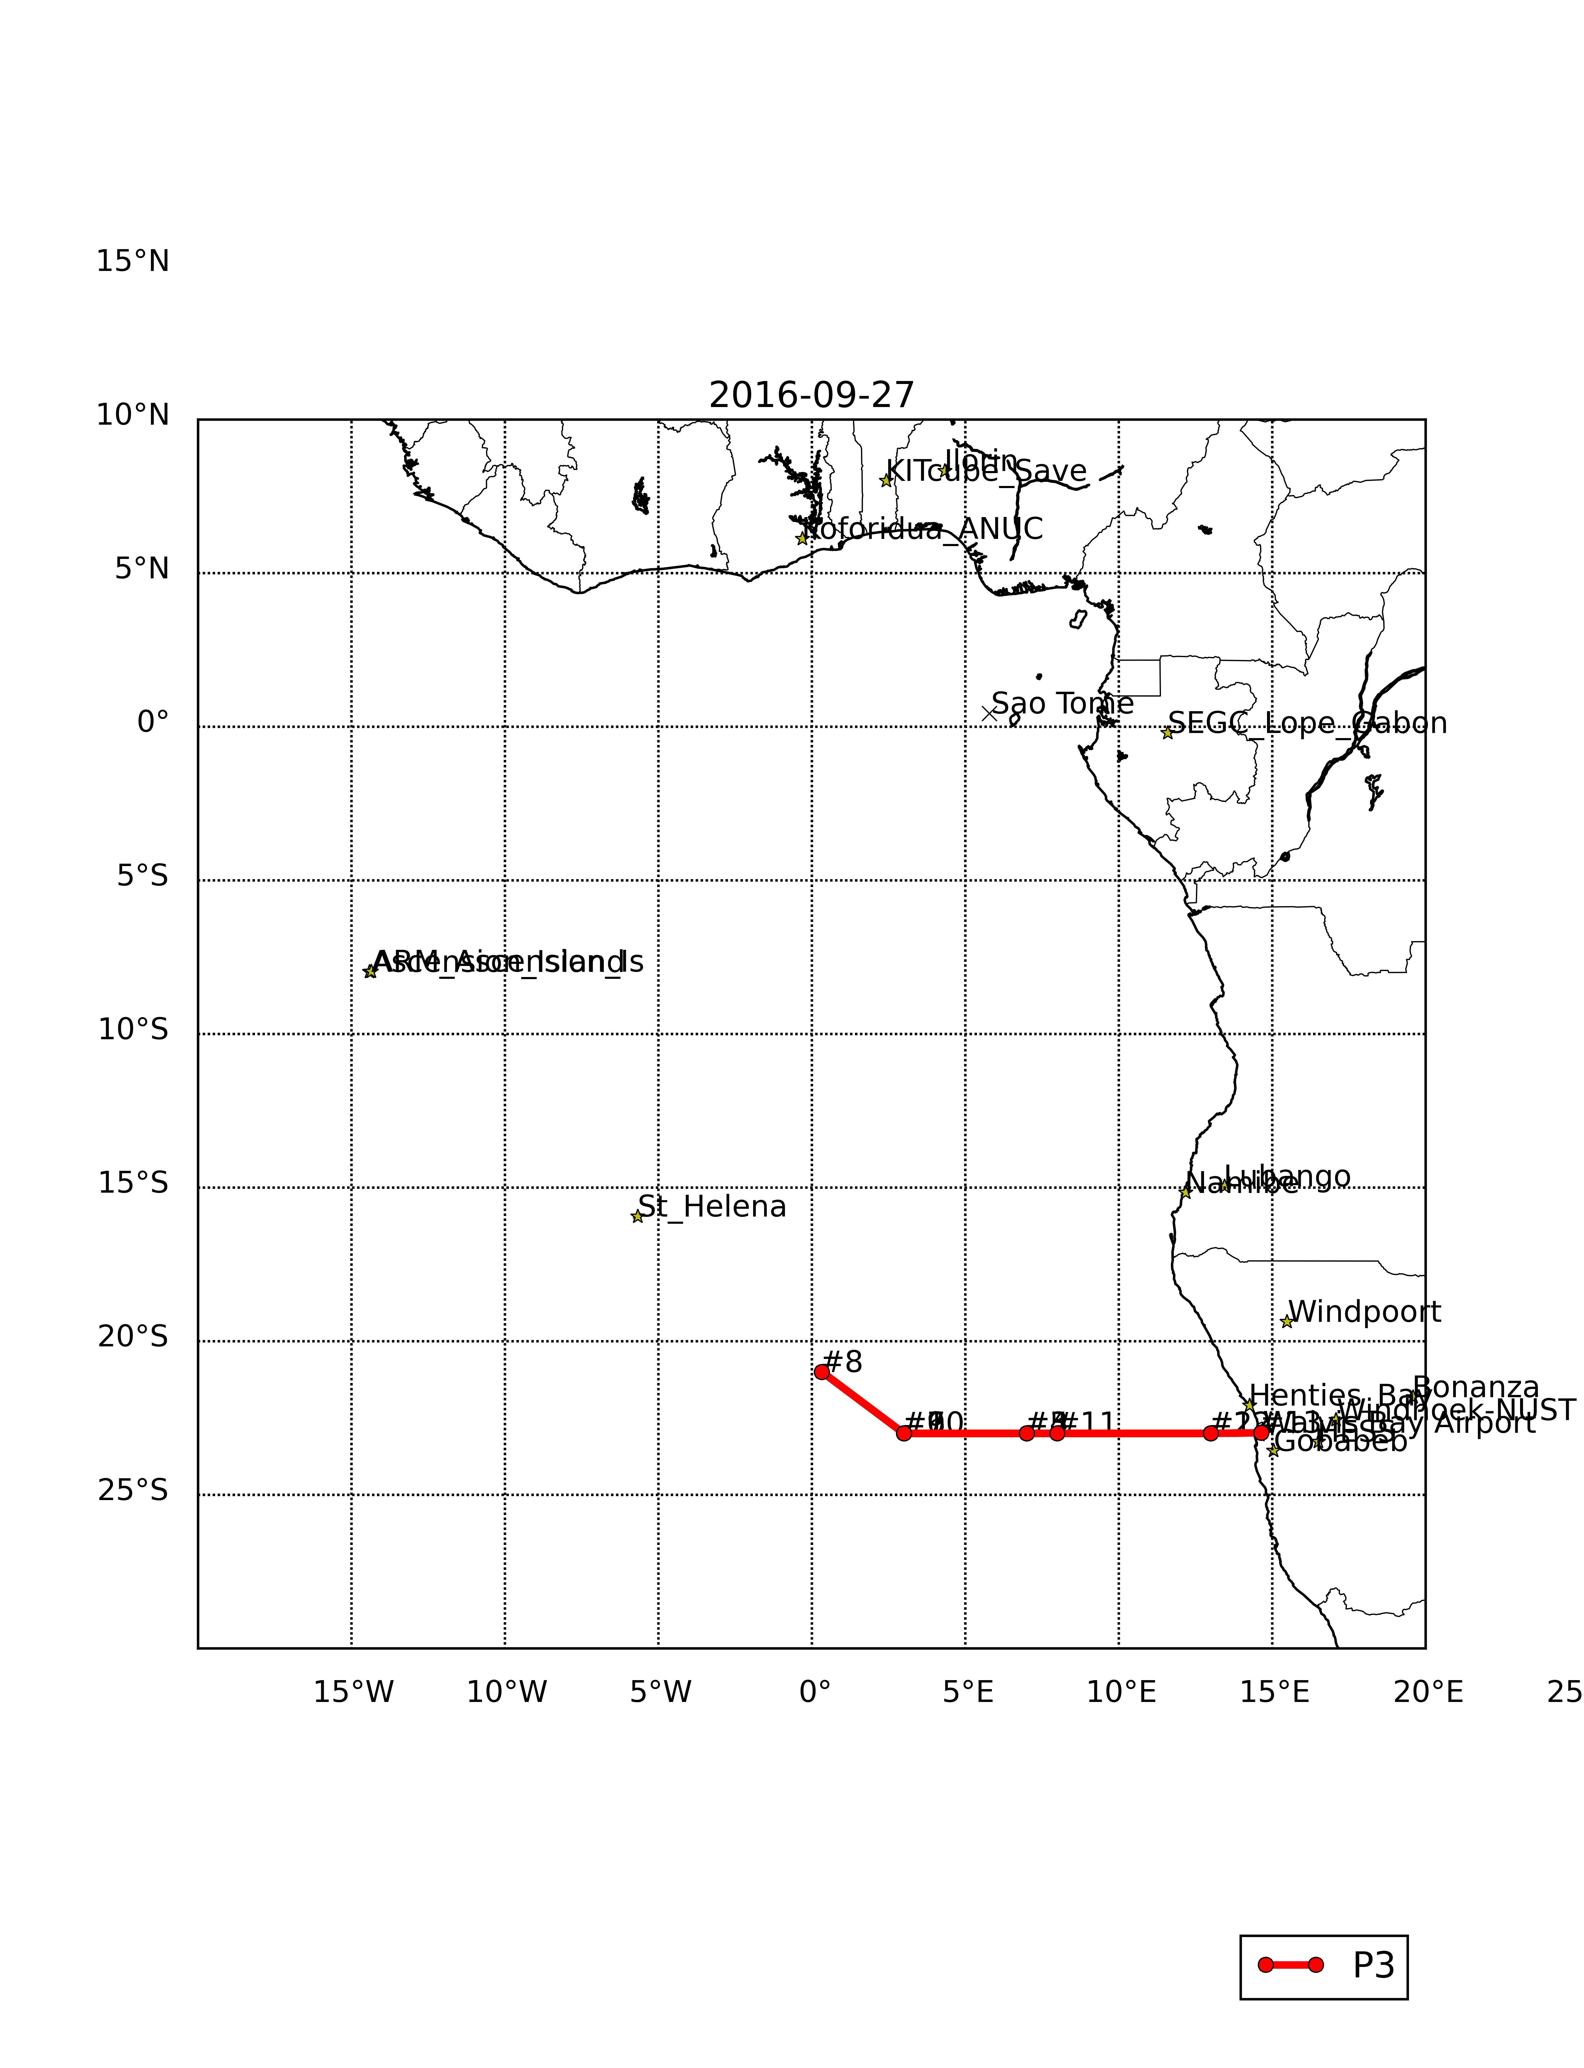
Tuesday 27 September 2016
Flight Day

Slide 16
Tuesday, 27 Sep 2016 9z

Slide 17
Tuesday, 27 Sep 2016 9z
HIGH

Slide 18
Tuesday, 27 Sep 2016 9z
MID

Slide 19
Tuesday, 27 Sep 2016 9z
LOW

Slide 21
Tuesday 17 September 2016 9Z

Slide 24
P3 Hockey Stick Track

Slide 26
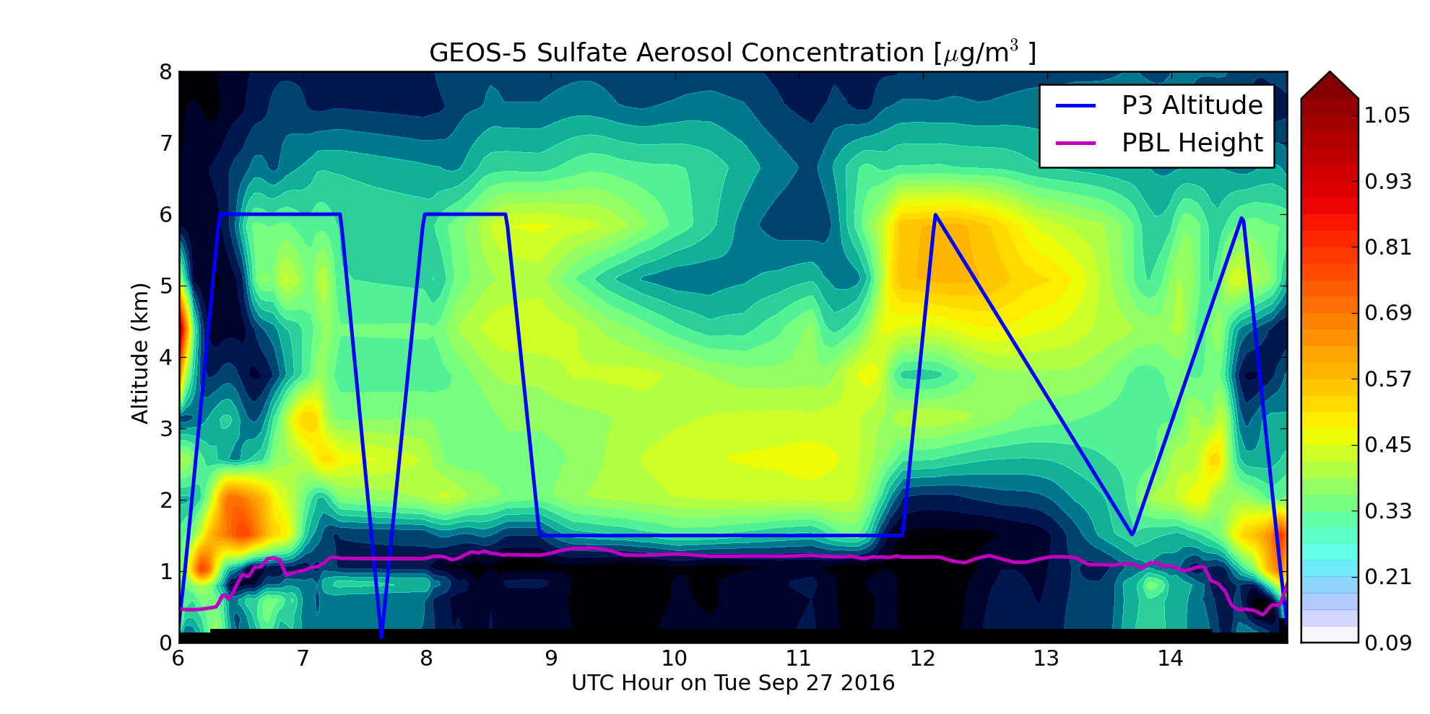

Slide 27
GEOS-5
WRF

Slide 28
GEOS-5
WRF

Slide 29
GEOS-5
WRF

Slide 30
GEOS-5
WRF

Slide 31
Thursday 29 September 2016
Transit Flight

Slide 32
Thursday, 29 September 2016 6z

